Slide 1
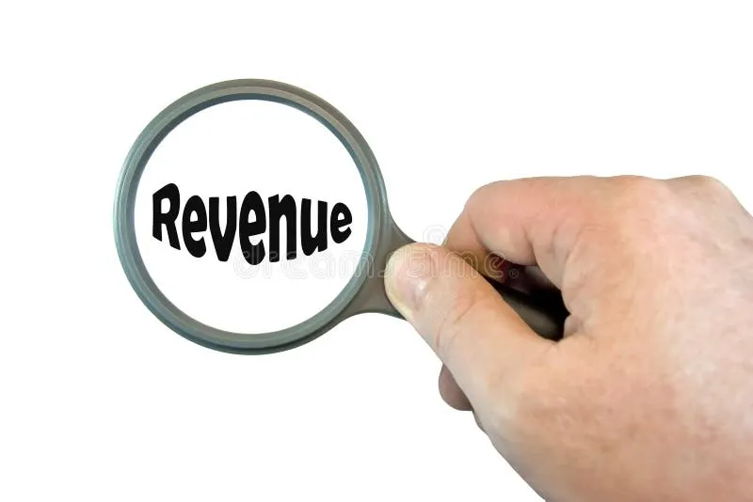
Discount Analysis
ENIAC Report
Date:27.10.2025
BY
Pranab Rudra, Surekha Jan, Aleksandra Dominika Gruszka

Slide 2
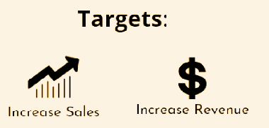
What is the effect of Discounts?
1
Notes:
Also new clients - but i don’t see the way to check it here…

Slide 3
Are Discounts on Products beneficial for Eniac?
2

Slide 4
Are Discounts on Products beneficial for Eniac?
At the right time and at reasonable range discounts can be allowed
2
Notes:
I would wait with telling the conclusion (actually that is what we usually we but Christopher explicitly told me to bring it up forward)

Slide 5
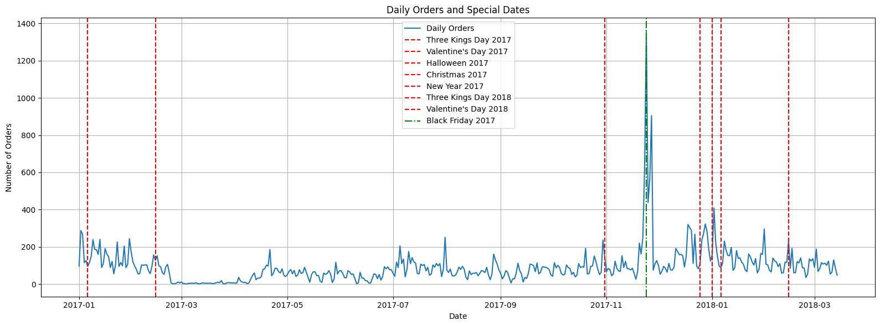
Seasonality
New Year
Black Friday
King’s Day
King’s Day
Valentine’s
Halloween
Christmas
Valentine’s

Slide 6
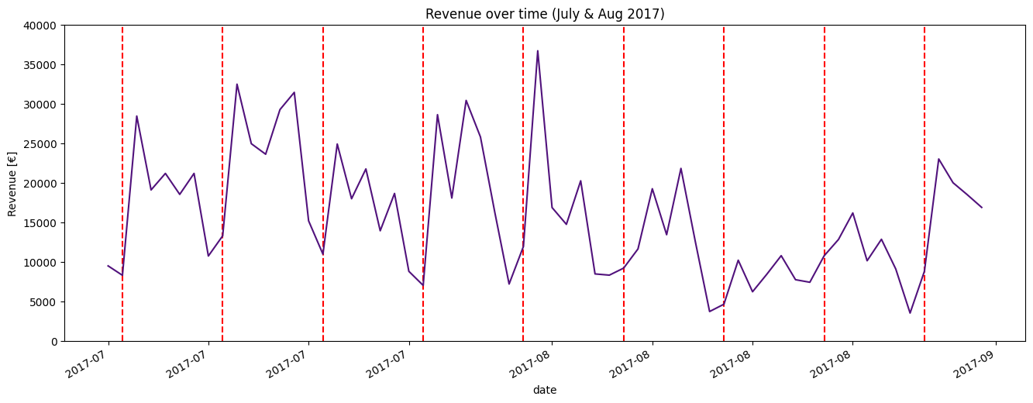
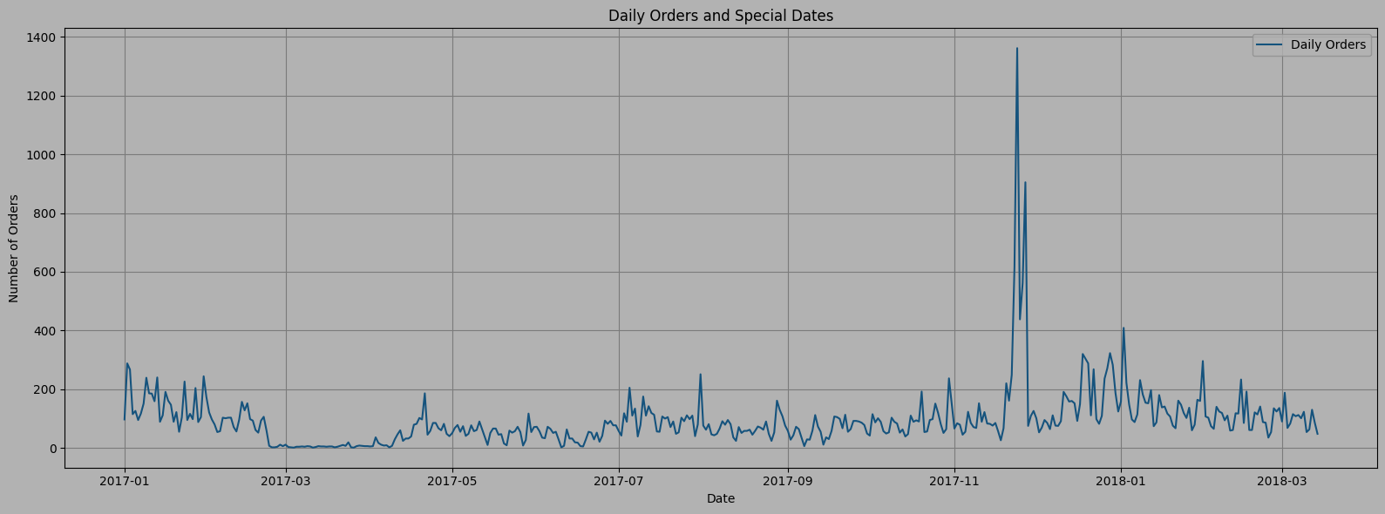

Slide 7
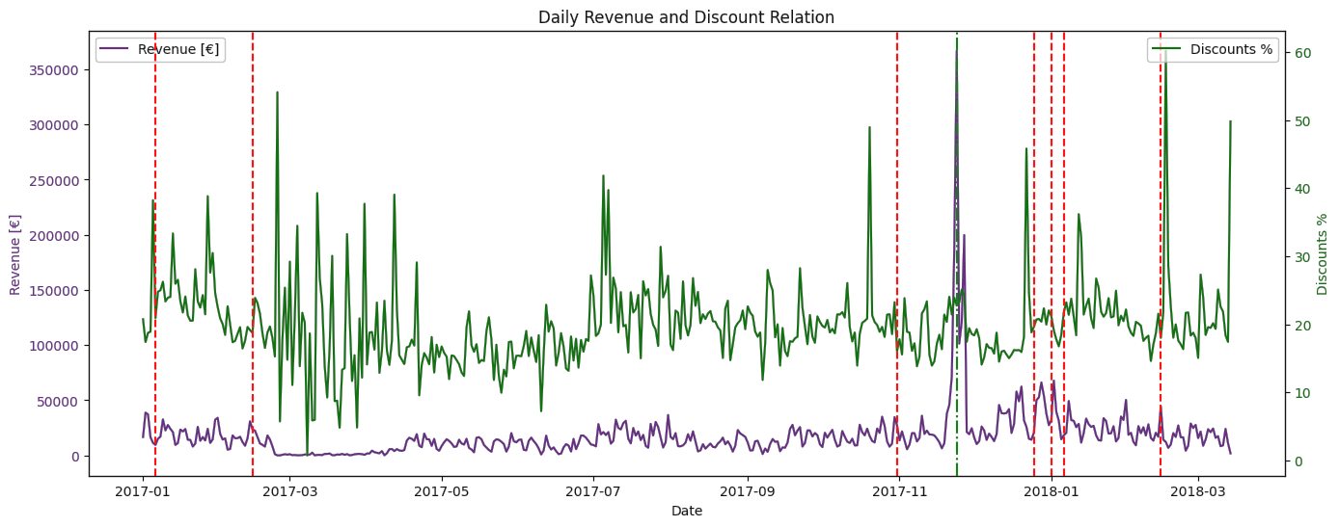
Seasonality
High discount
No impact

Slide 8
Seasonality
High discount
No impact

Slide 9
Seasonality
Lowest revenue

Slide 10
Seasonality
Slightly better revenue

Slide 11
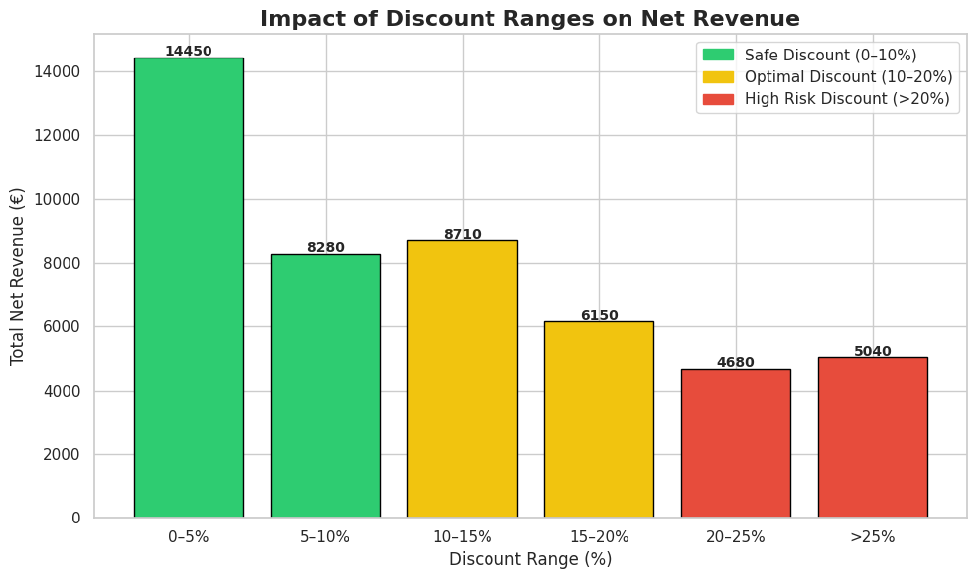
Total Net Revenue

Slide 12
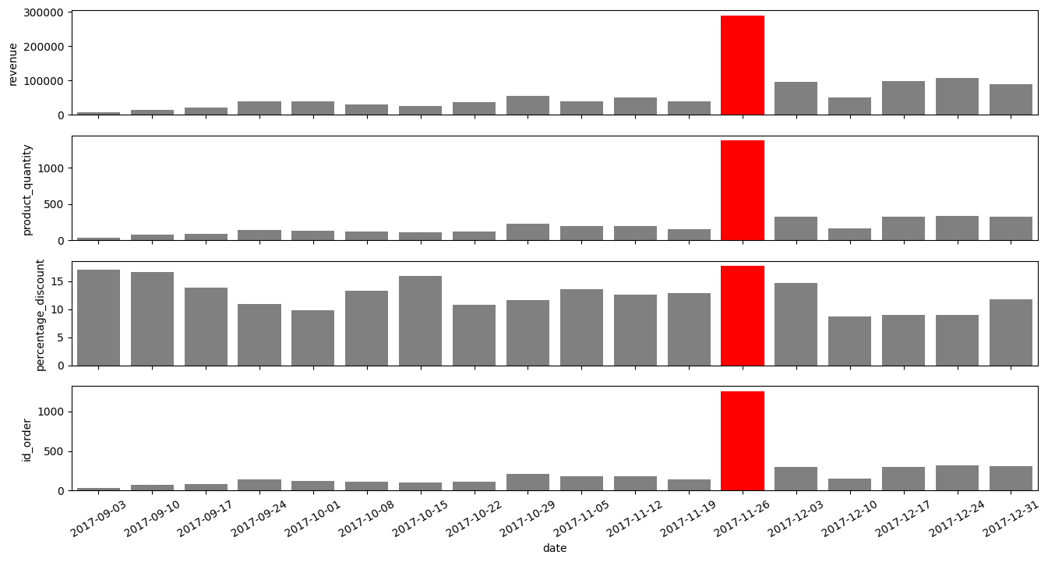
all apple products
Notes:
We decided to narrow down. Apple is the most sold/ popular brand and fall/winter 2017 seems to be where the most action is.
Even here, we can not say that discount implies more orders. The greater amount of orders seems to b related to a particular time of year rather than discount.NEXT

Slide 13
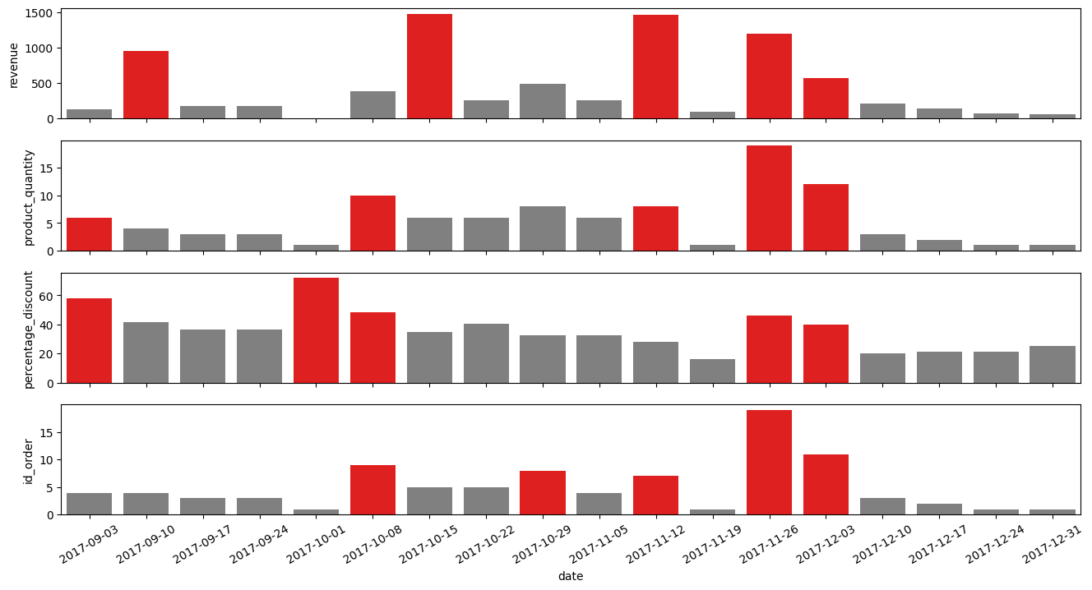
apple refurbished
Notes:
However some difference is to be seen when looking into refurbished vs new products: the used versions seem to be on higher demand up till the end of november, with no clear relation to the percentage discount, while bringing significantly higher revenue during a couple of weeks NEXT PLS

Slide 14
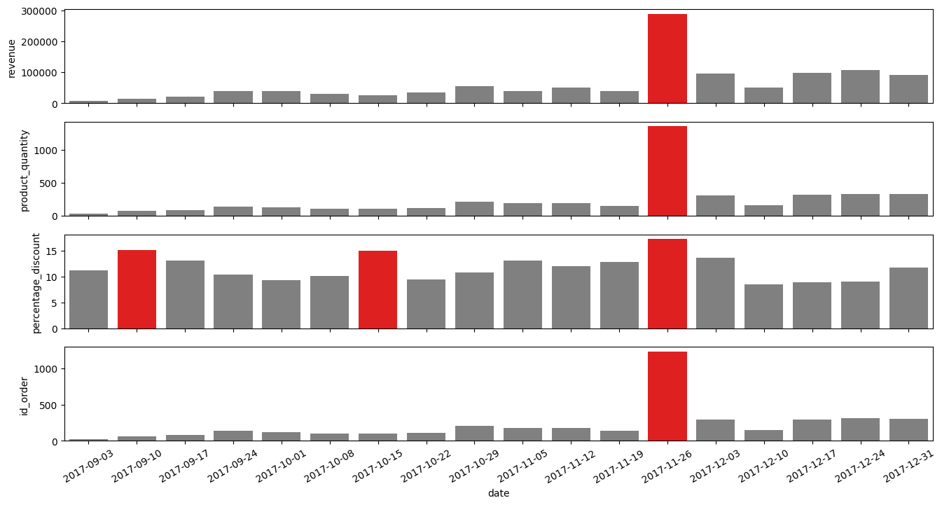
apple not refurbished
Notes:
The new ones r on higher demand mostly during one week on late Nov, and only then bring visibly higher revenue NEXT PLS

Slide 15
Upon further inspection of the orders:
new products buyers: 30% more_than-one-item orders
delivery cost?
refurbished products buyers: 50% more-than-one-item orders
'Akitio','Allocacoc','Beats','Crucial' 'Elago','Evutec','Griffin','LG', 'Otterbox', 'LaCie',’Lifeproof','Matias','Minibatt','Moxie','Nike','Ninebot','Nokia','Nonda','OWC',
'Plantronics','Samsung','SanDisk','Satechi','Startech','Wowewa','ZaggKeys','iFixit'
brand clusters?
‘Tucano’, ‘iOttie’
‘Warranty’, ‘Watch’,’Thunderbolt’,’Submersible’,
‘Altimeter’, ‘Leather’, ‘Glass’,’Design’
design / lifestyle?
‘Compatible’
Notes:
One third of new apple products and half of the used products r ordered with at least one other item. While looking into those combined orders’ items, one may see
there seem to b brands, products and features associated with only one or only the other category. That MAY suggest two very different types of clients and therefore need for different discounts strategies. More on that Pranab:

Slide 16
Conclusion
High discounts are not recommended since it does not imply high revenue

Slide 17
Recommendation
Reasonable discounts range
Data collection improvements
Longer data collection
Standardized product categorization

Slide 18

Questions?
Thank you!

Slide 19
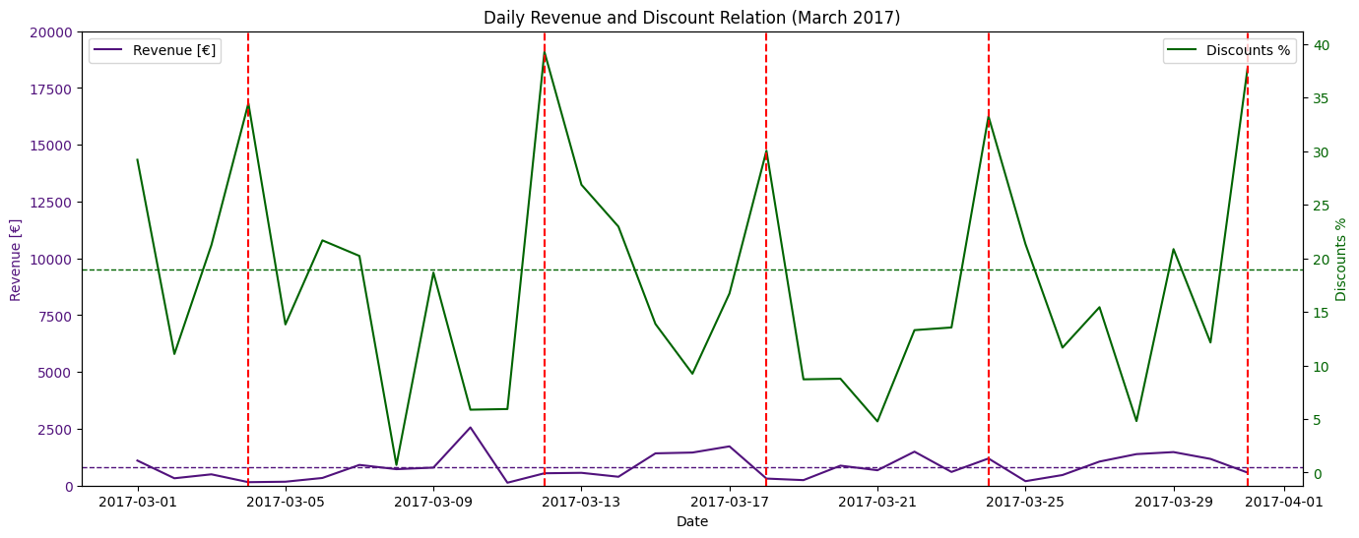
Further graphs confirming revenue does not change when discounts are increased
Notes:
Extra slides when explanation is required!!!

